Slide 1
Visualizing Insights and Analysis

Slide 2
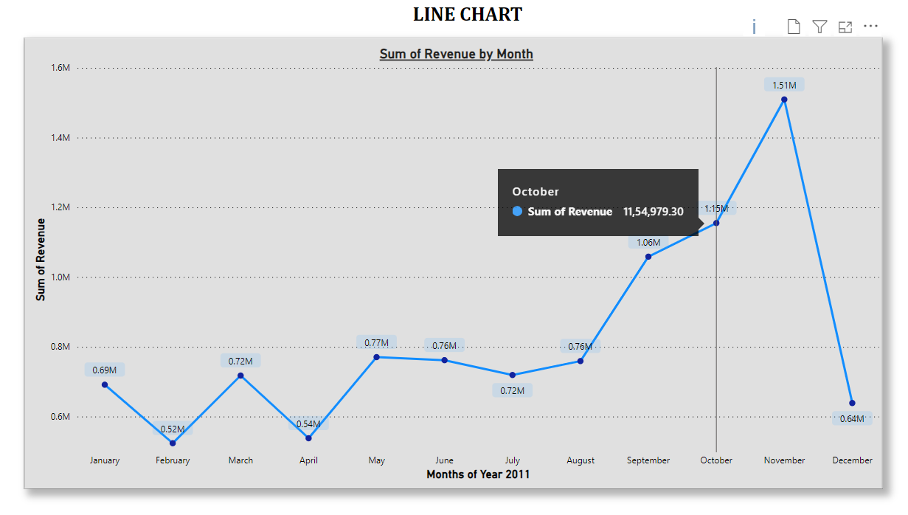
Time-Series Analysis – Line Chart
Question 1: Seasonal Revenue Trends in 2011
Time Series Analysis of revenue data for 2011 by Month.
Explores the seasonal revenue trends and their underlying causes.
Aids in forecasting for the upcoming year.

Slide 3
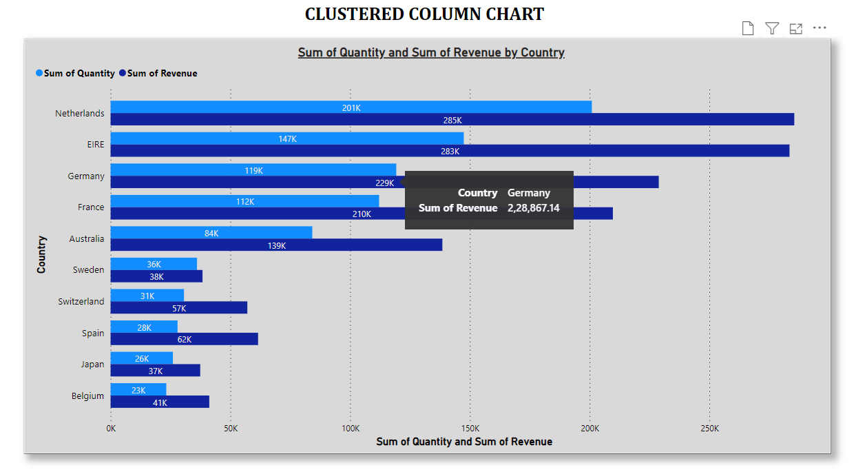
Market Analysis – Clustered Column Chart
Question 2: Top Revenue-Generating Countries
Displays the top 10 revenue-generating countries excluding the United Kingdom.
Includes information on the quantity sold.
Identifies key market for revenue and sales.

Slide 4
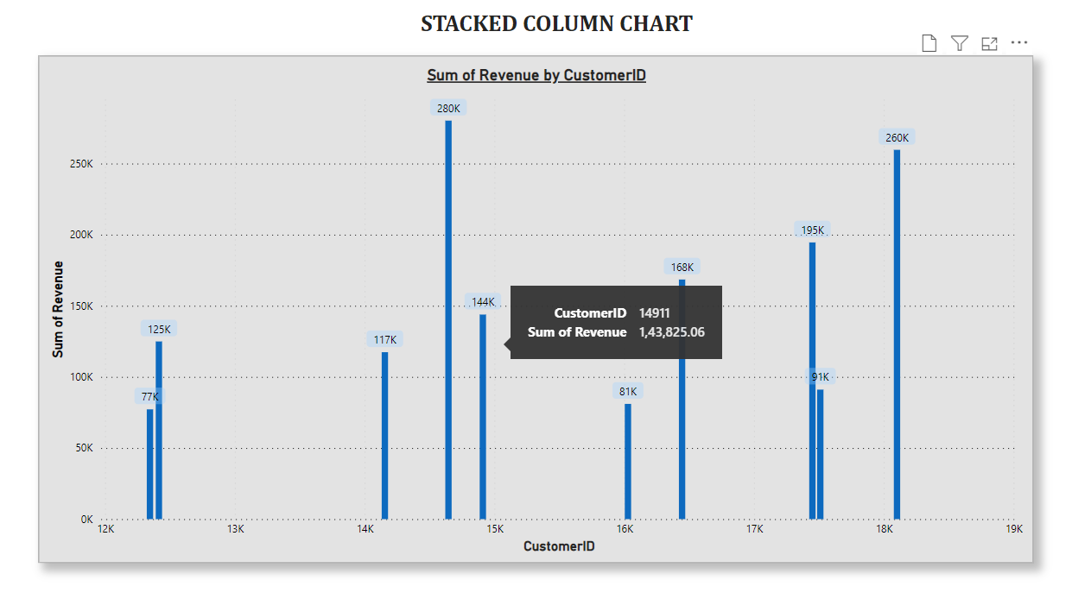
CRM Analysis – Stacked Column Chart
Question 3: Top Customers by Revenue
Visual ranking the top 10 customers by revenue, starting with the highest.
Ensures Satisfaction and Retention of High-Revenue Customers.
Strategic focus on Customer Relationship Management.

Slide 5
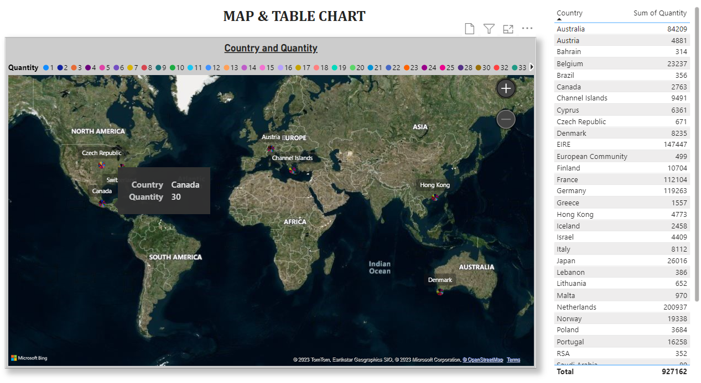
Demand Insights – Map Chart
Question 4: Regional Demand Insights
Map highlighting regions with the highest demand for products across all countries.
Facilitates expansion strategy by targeting regions with growth potential.
Single view, no need to scroll or hover, excluding the United Kingdom.

Slide 6
Conclusion
The visuals crafted based on the provided questions offer, Valuable and Comprehensive Insights into various aspects, to guide Strategic Decisions for the Retail Business.
Analyzing seasonal revenue trends, Identifying top revenue-generating countries and customers, and Understanding regional demand patterns are pivotal in Forecasting, Expansion Planning, and Customer Relationship Management.
These visuals provide a Comprehensive View of critical aspects, equipping the CEO and CMO with Actionable Insights to optimize Business Strategies and drive growth in the Retail Industry.
These visuals empower decision-makers to make informed choices and drive the Retail Business forward.

Slide 7
THANK YOU

